Slide 1

YTD Financial Presentation
Financial Review for the Fiscal Year 2021
Second Quarter Ending March 31, 2021

Slide 2
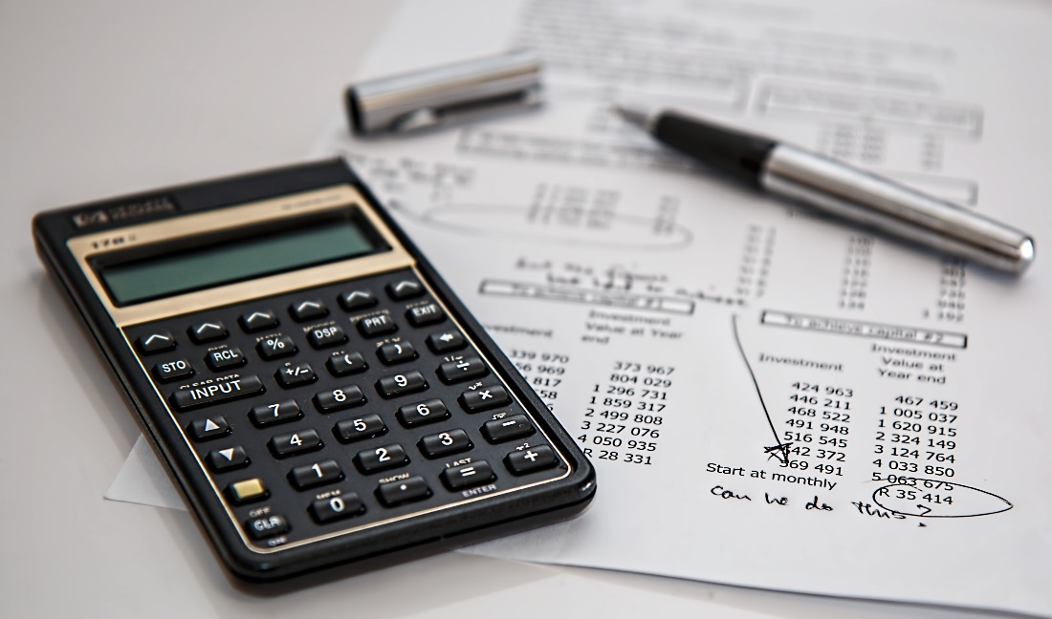
GENERAL FUND L FUND
REVENUE ANALYSIS
FOR THE PERIOD 10/1/2020 - 3/31/2021

Slide 3
General Fund Revenue
 | 2nd Qtr. Ending | FY 2021 | % of
Revenue | 3/31/2021 | Budget | Budget
Admin | $ 509,332 | $ 695,000 | 73.29%
Fire | $ 186,720 | $ 344,500 | 54.20%
ESD | $ 4,500 | $ 9,000 | 50.00%
Tax | $ 6,065,971 | $ 6,972,500 | 87.00%
Police | $ 20,525 | $ 20,500 | 100.12%
Dev Serv | $ 177,276 | $ 311,250 | 56.96%
Public Works | $ 568,314 | $ 692,750 | 82.04%
Mow & Clear | $ 366,730 | $ 455,000 | 80.60%
Interest | $ 2,366 | $ 45,000 | 5.26%
Total | $ 7,901,734 | $ 9,545,500 | 82.78%

Slide 4
EXPENDITURE ANALYSIS FOR THE PERIOD 10/1/2020 - 3/31/2021
GENERAL FUND

Slide 5
General Fund Expenditures
 | 2nd Qtr. Ending | FY 2021 | % of
Expenses | 3/31/2021 | Budget | Budget
Administration | $ 1,065,478 | $ 2,013,250 | 52.92%
Technical Serv | $ 143,045 | $ 319,250 | 44.81%
Fire | $ 1,173,333 | $ 2,502,000 | 46.90%
Police | $ 1,074,454 | $ 2,209,250 | 48.63%
Animal Control | $ 115,630 | $ 200,750 | 57.60%
Develop. Services | $ 344,013 | $ 785,000 | 43.82%
Public Works | $ 312,229 | $ 609,500 | 51.23%
Mowing & Clearing | $ 292,965 | $ 585,000 | 50.08%
Total | $ 4,521,147 | $ 9,224,000 | 49.02%

Slide 6

UTILITY FUND
REVENUE ANALYSIS
FOR THE PERIOD 10/1/2020 - 3/31/2021

Slide 7
Utility Fund Revenue
 | 2nd Qtr. Ending | FY 2021 | % of
Revenue | 3/31/2021 | Budget | Budget
Administration | $ 261,072 | $ 270,000 | 96.69%
Water Production | $ 1,978,864 | $ 4,953,250 | 39.95%
Wastewater Treatment | $ 1,765,068 | $ 3,471,000 | 50.85%
Solid Waste | $ 591,243 | $ 1,117,500 | 52.91%
Standby | $ 301 | $ 750 | 40.12%
Interest | $ 1,848 | $ 25,000 | 7.39%
Total | $ 4,598,396 | $ 9,837,500 | 46.74%

Slide 8
UTILITY FUND
EXPENDITURE ANALYSIS
FOR THE PERIOD 10/1/2020 - 3/31/2021

Slide 9
Utility Fund Expenditures
 | 2nd Qtr. Ending | FY 2021 | % of
Expenses | 3/31/2021 | Budget | Budget
Administration | $ 934,836 | $ 2,214,250 | 42.22%
Water Production | $ 415,508 | $ 1,024,000 | 40.58%
Distribution | $ 537,396 | $ 1,048,750 | 51.24%
Wastewater Treatment | $ 215,882 | $ 524,250 | 41.18%
Collection | $ 722,128 | $ 1,330,250 | 54.29%
Solid Waste | $ 399,113 | $ 901,500 | 44.27%
Debt Service | $ 604,697 | $ 1,463,000 | 41.33%
Total | $ 3,829,560 | $ 8,506,000 | 45.02%

Slide 10
GENERAL FUND & UTILITY FUND FOR THE PERIOD 10/1/2020 - 3/31/2021
CAPITAL EXPENDITURES

Slide 11
General Fund Capital Expenditures | YTD Balance as of 3/31/2021 | FY 2021 Budget | % of Budget
Administration
Equipment Replacement | $ 16,156 | $ 20,000 | 80.78%
Technology Services
MS 365 Gov. Exchange Migration | $ 6,426 | $ 10,000 | 64.26%
Capcog Ortho Imagery | $ 0 | $ 6,000 | 0.00%
Fire
Radio Grant- Llano County Fire Dept. | $ 0 | $ 5,000 | 0.00%
Police
Mobile Data Terminals (MDT) 6 units | $ 39,845 | $ 45,000 | 88.54%
Replacement of 2 units w/equipment | $ 86,420 | $ 90,000 | 96.02%
Development Services
Large Format Scanner | $ 0 | $ 10,000 | 0.00%
Public Works
New Service Truck | $ 60,000 | $ 60,000 | 100.00%
Total | $ 208,847 | $ 246,000 | 84.90%

Slide 12
Utility Fund Capital Expenditures | YTD Balance as of 3/31/2021 | FY 2021 Budget | % of Budget
Capital Outlay – Machine & Equipment
CWTP and West SCADA System Upgrade | $ 40,852 | $ 150,000 | 27.23%
Clarifier for Central Water Treatment Plant | $ 12,973 | $ 15,000 | 86.49%
Mixer for Central Plant | $ 15,621 | $ 22,000 | 71.00%
Water Quality and Auto Flushing Devices | $ 9,965 | $ 10,000 | 99.65%
Valve Out Flange Spreader | $ 7,039 | $ 8,000 | 87.99%
Ditch Witch | $ 10,476 | $ 28,000 | 37.41%
Water Meter Replacement & AMI System Upgrade | $ 62,622 | $ 225,000 | 27.83%
Emergency Equipment Replacement | $ 7,250 | $ 25,000 | 29.00%

Slide 13
Utility Fund Capital Expenditures (continued) | YTD Balance as of 3/31/2021 | FY 2021 Budget | % of Budget
Capital Outlay – Vehicles
Replace Service Trucks (3) | $ 113,636 | $ 109,000 | 104.25%
Capital Outlay – Building & Improvement
Alarm System for Central Water Plant | $ 17,024 | $ 20,000 | 85.12%
Capital Outlay – Sewer Line Improvements
South Lift Station Rehabilitation | $ 0 | $ 90,000 | 0.00%
Wastewater Reclamation Plant Expansion | $ 929,736 | $ 1,000,000 | 92.97%
Zebra Mussel Treatment | $ 59,884 | $ 309,000 | 19.38%
Totals | $ 1,287,078 | $ 2,011,000 | 64.00%

Slide 14
Thank You!
Any Questions?

