Slide 1

YTD Financial Presentation
Financial Review for the Fiscal Year 2021
First Quarter Ending December 31, 2020

Slide 2
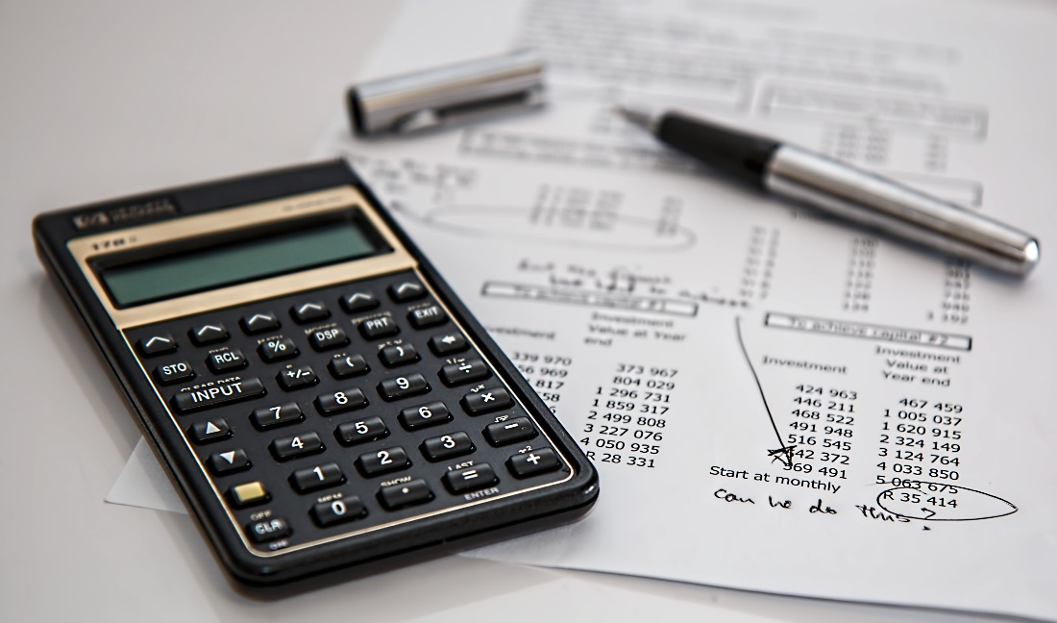
GENERAL FUND L FUND
REVENUE ANALYSIS
FOR THE PERIOD 10/1/2020 - 12/31/2020

Slide 3
General Fund Revenue
 | 1st Qtr. Ending | FY 2021 | % of
Revenue | 12/31/2020 | Budget | Budget
Admin | $ 186,217 | $ 695,000 | 26.79%
Fire | $ 96,286 | $ 344,500 | 27.95%
ESD | $ 2,250 | $ 9,000 | 25.00%
Tax | $ 2,804,651 | $ 6,972,500 | 40.22%
Police | $ 8,354 | $ 20,500 | 40.75%
Dev Serv | $ 87,616 | $ 311,250 | 28.15%
Public Works | $ 181,909 | $ 692,750 | 26.26%
Mow & Clear | $ 322,336 | $ 455,000 | 70.84%
Interest | $ 1,196 | $ 45,000 | 2.66%
Total | $ 3,690,815 | $ 9,454,500 | 38.67%

Slide 4
EXPENDITURE ANALYSIS FOR THE PERIOD 10/1/2020 - 12/31/2020
GENERAL FUND

Slide 5
General Fund Expenditures
 | 1st Qtr. Ending | FY 2021 | % of
Expenses | 12/31/2020 | Budget | Budget
Administration | $ 608,724 | $ 2,013,250 | 30.24%
Technical Serv | $ 72,115 | $ 319,250 | 22.59%
Fire | $ 600,560 | $ 2,502,000 | 24.00%
Police | $ 526,800 | $ 2,209,250 | 23.85%
Animal Control | $ 80,588 | $ 200,750 | 40.14%
Develop. Services | $ 171,500 | $ 785,000 | 21.85%
Public Works | $ 121,992 | $ 609,500 | 20.02%
Mowing & Clearing | $ 287,875 | $ 585,000 | 49.21%
Total | $ 2,470,154 | $ 9,224,000 | 26.78%

Slide 6

UTILITY FUND
REVENUE ANALYSIS
FOR THE PERIOD 10/1/2020 - 12/31/2020

Slide 7
Utility Fund
 | 1st Qtr. Ending | FY 2021 | % of
Revenue | 12/31/2020 | Budget | Budget
Administration | $ 112,996 | $ 270,000 | 41.85%
Production | $ 1,024,210 | $ 4,953,250 | 20.68%
WW Treatment | $ 776,271 | $ 3,471,000 | 22.36%
Solid Waste | $ 292,427 | $ 1,117,500 | 26.17%
Standby | $ 0 | $ 750 | 0.00%
Interest | $ 1,082 | $ 25,000 | 4.33%
Total | $ 2,206,986 | $ 9,837,500 | 22.43%

Slide 8
UTILITY FUND
EXPENDITURE ANALYSIS
FOR THE PERIOD 10/1/2020 - 12/31/2020

Slide 9
Utility Fund
 | 1st Qtr. Ending | FY 2021 | % of
Expenses | 12/31/2020 | Budget | Budget
Administration | $ 467,148 | $ 2,214,750 | 21.10%
Production | $ 196,357 | $ 1,024,000 | 19.18%
Distribution | $ 280,887 | $ 1,048,750 | 26.78%
WW Treatment | $ 104,083 | $ 524,250 | 19.85%
Collection | $ 361,608 | $ 1,330,250 | 27.18%
Solid Waste | $ 166,821 | $ 901,500 | 18.50%
Debt Service | $ 0 | $ 1,463,000 | 0%
Total | $ 1,576,904 | $ 8,506,000 | 18.54%

Slide 10
GENERAL FUND & UTILITY FUND FOR THE PERIOD 10/1/2020 - 12/31/2020
CAPITAL EXPENDITURES

Slide 11
General Fund Capital Expenditures | YTD Balance as of 12/31/2020 | FY 2021 Budget | % of Budget
Administration
Equipment Replacement | $ 2,673 | $ 20,000 | 100.00%
Technology Services
MS 365 Gov. Exchange Migration | $ 6,426 | $ 10,000 | 64.26%
Capcog Ortho Imagery | $ 0 | $ 6,000 | 0.00%
Fire
Radio Grant- Llano County Fire Dept. | $ 0 | $ 5,000 | 0.00%
Police
Mobile Data Terminals (MDT) 6 units | $ 38,416 | $ 45,000 | 85.37%
Replacement of 2 units w/equipment | $ 0 | $ 90,000 | 0.00%
Development Services
Large Format Scanner | $ 0 | $ 10,000 | 0.00%
Public Works
New Service Truck | $ 0 | $ 60,000 | 0.00%
Total | $ 47,515 | $ 246,000 | 19.31%

Slide 12
Utility Fund Capital Expenditures | YTD Balance as of 12/31/2020 | FY 2021 Budget | % of Budget
Capital Outlay – Machine & Equipment
CWTP and West SCADA System Upgrade | $ 0 | $ 150,000 | 0%
Clarifier for Central Water Treatment Plant | $ 0 | $ 15,000 | 0%
Mixer for Central Plant | $ 0 | $ 22,000 | 0%
Water Quality and Auto Flushing Devices | $ 0 | $ 10,000 | 0%
Valve Out Flange Spreader | $ 7,039 | $ 8,000 | 87.99%
Ditch Witch | $ 10,476 | $ 28,000 | 37.41%
Water Meter Replacement & AMI System Upgrade | $ 40,193 | $ 225,000 | 17.86%
Emergency Equipment Replacement | $ 0 | $ 25,000 | 0%

Slide 13
Utility Fund Capital Expenditures (continued) | YTD Balance as of 12/31/2020 | FY 2021 Budget | % of Budget
Capital Outlay – Vehicles
Replace Service Trucks (3) | $ 113,636 | $ 109,000 | 104.25%
Capital Outlay – Building & Improvement
Alarm System for Central Water Plant | $ 14,419 | $ 20,000 | 72.10%
Capital Outlay – Sewer Line Improvements
South Lift Station Rehabilitation | $ 0 | $ 90,000 | 0.00%
Wastewater Reclamation Plant Expansion | $ 566,473 | $ 1,000,000 | 56.65%
Zebra Mussel Treatment | $ 16,105 | $ 309,000 | 5.21%
Totals | $ 768,341 | $ 2,011,000 | 38.21%

Slide 14
Thank You!
Any Questions?

