Slide 1

YTD Financial Presentation
Financial Review for the Fiscal Year 2021
Third Quarter Ending June 30, 2021

Slide 2
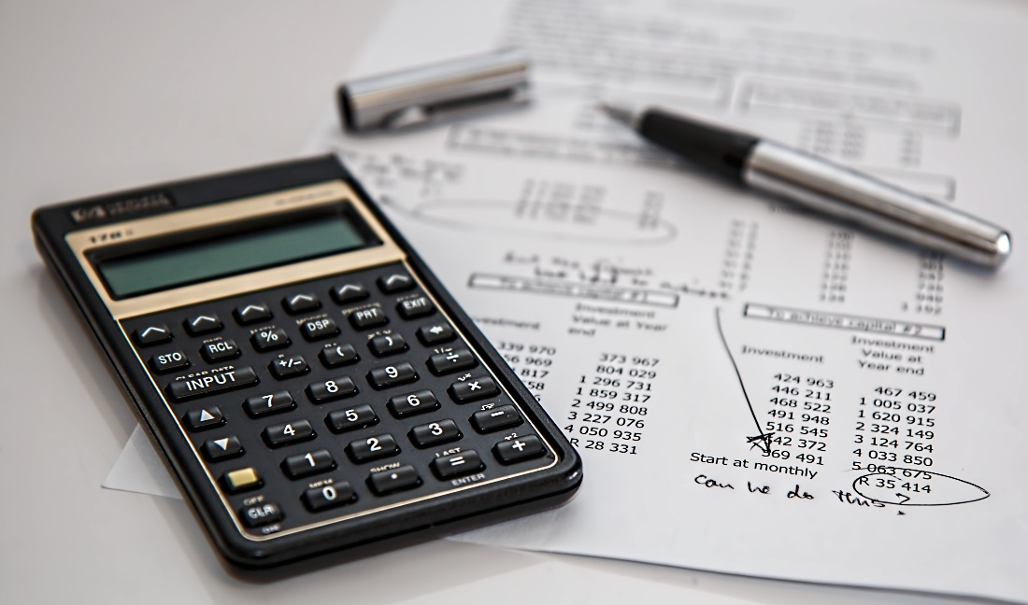
GENERAL FUND
L FUND
REVENUE ANALYSIS
FOR THE PERIOD 10/1/2020 - 6/30/2021

Slide 3
General Fund Revenue
 | FYTD Ending | FY 2021 | % of
Revenue | 6/30/2021 | Budget | Budget
Admin | $ 669,126 | $ 874,500 | 76.52%
Fire | $ 272,955 | $ 372,000 | 73.38%
ESD | $ 6,750 | $ 9,000 | 75.00%
Tax | $ 6,707,271 | $ 6,972,500 | 96.20%
Police | $ 20,549 | $ 20,500 | 100.24%
Dev Serv | $ 313,313 | $ 318,250 | 98.45%
Public Works | $ 678,569 | $ 696,750 | 97.39%
Mow & Clear | $ 415,429 | $ 455,000 | 91.30%
Interest | $ 2,924 | $ 5,000 | 58.49%
Total | $ 9,086,886 | $ 9,723,500 | 93.45%

Slide 4
EXPENDITURE ANALYSIS
FOR THE PERIOD 10/1/2020 - 6/30/2021
GENERAL FUND

Slide 5
General Fund Expenditures
 | FYTD Ending | FY 2021 | % of
Expenses | 6/30/2021 | Budget | Budget
Administration | $ 1,532,140 | $ 2,040,250 | 75.10%
Technical Serv | $ 183,104 | $ 319,250 | 57.35%
Fire | $ 1,840,231 | $ 2,540,500 | 72.44%
Police | $ 1,649,017 | $ 2,196,250 | 75.08%
Animal Control | $ 153,984 | $ 200,750 | 76.70%
Develop. Services | $ 538,351 | $ 787,000 | 68.41%
Public Works | $ 450,754 | $ 624,500 | 72.18%
Mowing & Clearing | $ 460,977 | $ 585,000 | 78.80%
Total | $ 6,808,558 | $ 9,293,500 | 73.26%

Slide 6

UTILITY FUND
REVENUE ANALYSIS
FOR THE PERIOD 10/1/2020 - 6/30/2021

Slide 7
Utility Fund Revenue
 | FYTD Ending | FY 2021 | % of
Revenue | 6/30/2021 | Budget | Budget
Administration | $ 333,021 | $ 309,500 | 107.60%
Water Production | $ 3,223,801 | $ 4,953,250 | 65.08%
Wastewater Treatment | $ 2,916,630 | $ 3,471,000 | 84.03%
Solid Waste | $ 898,174 | $ 1,117,500 | 80.37%
Standby | $ 470 | $ 750 | 62.66%
Interest | $ 2,445 | $ 5,000 | 48.90%
Total | $ 7,374,541 | $ 9,857,000 | 74.82%

Slide 8
UTILITY FUND
EXPENDITURE ANALYSIS
FOR THE PERIOD 10/1/2020 - 6/30/2021

Slide 9
Utility Fund Expenditures
 | FYTD Ending | FY 2021 | % of
Expenses | 6/30/2021 | Budget | Budget
Administration | $ 1,431,443 | $ 2,199,250 | 65.09%
Water Production | $ 671,039 | $ 1,039,000 | 64.59%
Distribution | $ 812,807 | $ 1,064,000 | 76.39%
Wastewater Treatment | $ 359,905 | $ 534,250 | 67.37%
Collection | $ 1,157,736 | $ 1,376,500 | 84.11%
Solid Waste | $ 701,114 | $ 901,500 | 77.77%
Debt Service | $ 605,503 | $ 1,463,000 | 41.39%
Total | $ 5,739,547 | $ 8,577,500 | 66.91%

Slide 10
GENERAL FUND &
UTILITY FUND
FOR THE PERIOD 10/1/2020 - 6/30/2021
CAPITAL EXPENDITURES

Slide 11
General Fund Capital Expenditures | FYTD Ending 6/30/2021 | FY 2021 Budget | % of Budget
Administration
Equipment Replacement | $ 16,156 | $ 52,000 | 31.07%
Technology Services
MS 365 Gov. Exchange Migration | $ 6,426 | $ 10,000 | 64.26%
Capcog Ortho Imagery | $ 3,750 | $ 6,000 | 62.50%
Police
Mobile Data Terminals (MDT) 6 units | $ 39,845 | $ 40,000 | 99.61%
Purchase of UTV | $ 0 | $ 18,000 | 00.00%
Replacement of 2 units w/equipment | $ 90,151 | $ 90,000 | 100.17%
Development Services
Large Format Scanner | $ 0 | $ 10,000 | 0.00%
Public Works
New Service Truck | $ 60,000 | $ 60,000 | 100.00%
Total | $ 216,328 | $ 286,000 | 75.64%

Slide 12
Utility Fund Capital Expenditures | FYTD Ending 6/30/2021 | FY 2021 Budget | % of Budget
Capital Outlay – Machine & Equipment
CWTP and West SCADA System Upgrade | $ 63,786 | $ 150,000 | 42.52%
Clarifier for Central Water Treatment Plant | $ 14,352 | $ 15,000 | 95.68%
Mixer for Central Plant | $ 15,621 | $ 22,000 | 71.00%
Water Quality and Auto Flushing Devices | $ 9,965 | $ 10,000 | 99.65%
Valve Out Flange Spreader | $ 7,039 | $ 8,000 | 87.99%
Ditch Witch | $ 10,476 | $ 10,500 | 99.77%
Water Meter Replacement & AMI System Upgrade | $ 193,332 | $ 181,500 | 106.81%
Fence | $ 0 | $ 43,500 | 0.00%
Emergency Equipment Replacement | $ 17,834 | $ 85,000 | 20.98%

Slide 13
Utility Fund Capital Expenditures (continued) | FYTD Ending 6/30/2021 | FY 2021 Budget | % of Budget
Capital Outlay – Vehicles
Replace Service Trucks (3) | $ 113,636 | $ 109,000 | 104.25%
Capital Outlay – Building & Improvement
Alarm System for Central Water Plant | $ 17,024 | $ 20,000 | 85.12%
Capital Outlay – Sewer Line Improvements
South Lift Station Rehabilitation | $ 72,456 | $ 97,000 | 74.70%
Wastewater Reclamation Plant Expansion | $ 1,056,379 | $ 1,325,000 | 79.73%
Zebra Mussel Treatment | $ 140,254 | $ 152,000 | 92.27%
Totals | $ 1,732,155 | $ 2,228,500 | 77.73%

Slide 14
Thank You!
Any Questions?

