Slide 1

YTD Financial Presentation
Financial Review for the Fiscal Year 2021
Third Quarter Ending September 30, 2021

Slide 2
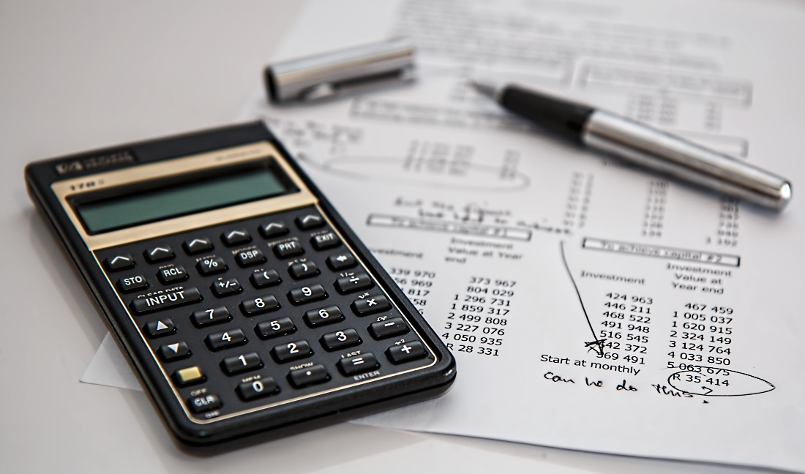
GENERAL FUND
L FUND
REVENUE ANALYSIS
FOR THE PERIOD 10/1/2020 - 9/30/2021

Slide 3
General Fund Revenue
 | FYTD Ending | FY 2021 | % of
Revenue | 9/30/2021 | Budget | Budget
Admin | $ 867,216 | $ 874,500 | 99.17%
Fire | $ 375,514 | $ 372,000 | 100.94%
ESD | $ 9,000 | $ 9,000 | 100.00%
Tax | $ 7,543,859 | $ 6,972,500 | 108.19%
Police | $ 21,020 | $ 20,500 | 102.53%
Dev Serv | $ 431,618 | $ 318,250 | 135.62%
Public Works | $ 849,292 | $ 696,750 | 121.89%
Mow & Clear | $ 455,628 | $ 455,000 | 100.14%
Interest | $ 3,722 | $ 5,000 | 74.45%
Total | $ 10,556,869 | $ 9,723,500 | 108.57%

Slide 4
EXPENDITURE ANALYSIS
FOR THE PERIOD 10/1/2020 - 9/30/2021
GENERAL FUND

Slide 5
General Fund Expenditures
 | FYTD Ending | FY 2021 | % of
Expenses | 9/30/2021 | Budget | Budget
Administration | $ 1,946,600 | $ 2,040,250 | 95.41%
Technical Serv | $ 269,830 | $ 319,250 | 84.52%
Fire | $ 2,499,173 | $ 2,540,500 | 98.37%
Police | $ 2,244,307 | $ 2,196,250 | 102.19%
Animal Control | $ 176,613 | $ 200,750 | 87.98%
Develop. Services | $ 749,132 | $ 787,000 | 95.19%
Public Works | $ 594,953 | $ 624,500 | 95.27%
Mowing & Clearing | $ 627,912 | $ 585,000 | 107.34%
Total | $ 9,108,520 | $ 9,293,500 | 98.01%

Slide 6

UTILITY FUND
REVENUE ANALYSIS
FOR THE PERIOD 10/1/2020 - 9/30/2021

Slide 7
Utility Fund Revenue
 | FYTD Ending | FY 2021 | % of
Revenue | 9/30/2021 | Budget | Budget
Administration | $ 902,429 | $ 309,500 | 291.57%
Water Production | $ 4,790,240 | $ 4,953,250 | 96.71%
Wastewater Treatment | $ 4,103,549 | $ 3,471,000 | 118.22%
Solid Waste | $ 1,203,978 | $ 1,117,500 | 107.74%
Standby | $ 628 | $ 750 | 83.80%
Interest | $ 2,820 | $ 5,000 | 56.40%
Total | $ 11,003,644 | $ 9,857,000 | 111.55%

Slide 8
UTILITY FUND
EXPENDITURE ANALYSIS
FOR THE PERIOD 10/1/2020 - 9/30/2021

Slide 9
Utility Fund Expenditures
 | FYTD Ending | FY 2021 | % of
Expenses | 9/30/2021 | Budget | Budget
Administration | $ 1,997,093 | $ 2,199,250 | 90.81%
Water Production | $ 964,902 | $ 1,039,000 | 92.87%
Distribution | $ 1,118,621 | $ 1,064,000 | 105.13%
Wastewater Treatment | $ 503,605 | $ 534,250 | 94.26%
Collection | $ 1,654,518 | $ 1,376,500 | 120.20%
Solid Waste | $ 958,945 | $ 901,500 | 106.37%
Debt Service | $ 1,465,249 | $ 1,463,000 | 100.15%
Total | $ 8,662,933 | $ 8,577,500 | 101.00%

Slide 10
GENERAL FUND &
UTILITY FUND
FOR THE PERIOD 10/1/2020 - 9/30/2021
CAPITAL EXPENDITURES

Slide 11
General Fund Capital Expenditures | FYTD Ending 9/30/2021 | FY 2021 Budget | % of Budget
Administration
Equipment Replacement | $ 18,280 | $ 52,000 | 35.15%
Technology Services
MS 365 Gov. Exchange Migration | $ 11,939 | $ 10,000 | 119.39%
Capcog Ortho Imagery | $ 3,750 | $ 6,000 | 62.50%
Police
Mobile Data Terminals (MDT) 6 units | $ 39,845 | $ 40,000 | 99.61%
Purchase of UTV | $ 17,980 | $ 18,000 | 99.89%
Replacement of 2 units w/equipment | $ 90,331 | $ 90,000 | 100.37%
Development Services
Large Format Scanner | $ 0 | $ 10,000 | 0.00%
Public Works
New Service Truck | $ 60,000 | $ 60,000 | 100.00%
Total | $ 242,125 | $ 286,000 | 84.66%

Slide 12
Utility Fund Capital Expenditures | FYTD Ending 9/30/2021 | FY 2021 Budget | % of Budget
Capital Outlay – Machine & Equipment
CWTP and West SCADA System Upgrade | $ 143,171 | $ 150,000 | 95.45%
Clarifier for Central Water Treatment Plant | $ 14,352 | $ 15,000 | 95.68%
Mixer for Central Plant | $ 15,621 | $ 22,000 | 71.00%
Water Quality and Auto Flushing Devices | $ 9,965 | $ 10,000 | 99.65%
Valve Out Flange Spreader | $ 7,039 | $ 8,000 | 87.99%
Ditch Witch | $ 10,476 | $ 10,500 | 99.77%
Water Meter Replacement & AMI System Upgrade | $ 201,982 | $ 181,500 | 111.28%
Fence | $ 40,000 | $ 43,500 | 91.95%
Emergency Equipment Replacement | $ 31,631 | $ 85,000 | 37.21%

Slide 13
Utility Fund Capital Expenditures (continued) | FYTD Ending 9/30/2021 | FY 2021 Budget | % of Budget
Capital Outlay – Vehicles
Replace Service Trucks (3) | $ 113,636 | $ 109,000 | 104.25%
Capital Outlay – Building & Improvement
Alarm System for Central Water Plant | $ 17,024 | $ 20,000 | 85.12%
Capital Outlay – Sewer Line Improvements
South Lift Station Rehabilitation | $ 103,762 | $ 97,000 | 106.97%
Wastewater Reclamation Plant Expansion | $ 1,385,166 | $ 1,325,000 | 104.54%
Zebra Mussel Treatment | $ 148,003 | $ 152,000 | 97.37%
Totals | $ 2,241,828 | $ 2,228,500 | 100.60%

Slide 14
Thank You!
Any Questions?

